Slide 1
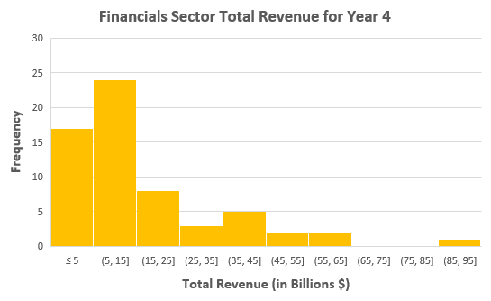
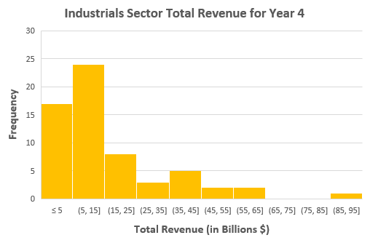
Does the Total Revenue of the Industrials Sector exceed that of the Financial Sector for Year 4?
The Total Revenue for both Financials and Industrials Sector companies for Year 4 are being reported in the histogram charts above.
From the charts above, both sector companies are rightly(positively) skewed and this simply means that each of their mean is higher than their median. The mean of the financials sector companies($20.6 billion) is higher than that of the industrials sector companies which is around $16.5 billion. The median of the financial sector ($10.3 billion) slightly exceeds that of the industrial sector ($9.9 billion). Likewise, the financial sector has a standard deviation of $25.6 billion whereas that of the industrial sector is $17.8 billion. This simply means that there is high variability in total revenue for the financial sector companies than the industrials sector companies.
The Industrials sector companies has a slightly higher range of $92.9 billion compared to the financials sector companies of $91.7 billion for Year 4. This means that industrials sector companies has more spread than the financials sector companies being that the industrial sector companies has a count of 62 while the financial sector companies is 41 companies.

